Slide 1

Performance accessment based on behavior Pattern
Xi Zhang
University of Science and Technology of China
Presented by Crystal
University of Science and Technology of China

Slide 2

Students with poor performance
Behavior in daily life

Slide 3

Backgroud
University of China
Small social system
Opportunity
Information-based education
Rich data
Basic Information
Course Performance
Tracing Record
Identity Authentication

Slide 4
Backgroud
Academic performance
The key inficators to evalutate educational level
Discovering students with poor performance
Effective supervision
Developing good study habits

Slide 5
Objective
Given: smart card records
Given: students' performance labels
Goal:
Build behavior pattern and extract features
Discover students with poor performance
Mine the relevance between behaviors and performance

Slide 6
Framework
B
Smart Card Reconds
Behavior Sequences
Hidden Markow Model
Performance
Behavior Pattern Building
Statistic Features
Relevant Features
Multitask Model
Behavior Feature Extration
0
0
...
1
1
0
...
0
0
1
...
0

Slide 7
Solution
1
Building Behavior Pattern
Event
UID | DEALTIME | MONEY | ORGINID | DEALCODE
U1 | 2015-03-02 09:29:39 | 400 | 1 | 04
U1 | 2015-03-02 09:47:31 | 2.8 | 1020002002 | 20
U1 | 2015-03-02 11:56:03 | 2.5 | 1020002 | 20
U1 | 2015-03-02 11:56:23 | 5 | 1020002 | 20
U1 | 2015-03-02 17:34:46 | 2 | 1049 | 20
... | ... | ... | ... | ...
Activity
Activity
Sequences
Behavior
Behavior Sequence

Slide 8
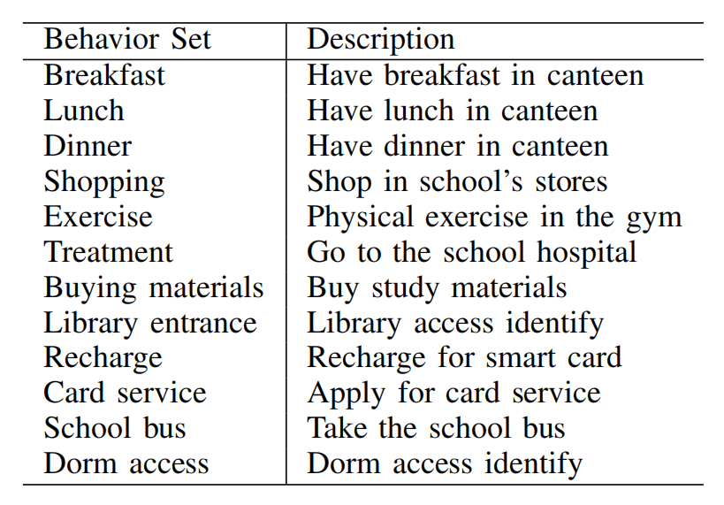
Solution
2.1
Behavior Features Extraction

Slide 9
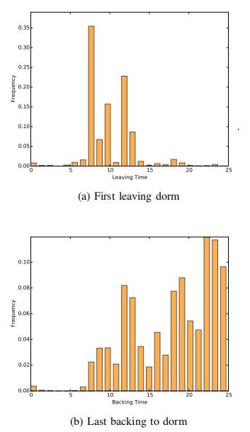
Solution
2.2
Statistics Features
Additional behaviors
Meal
Meal at weekends
Dorm access
Leaving before 8 a.m
Backing after 10 p.m

Slide 10
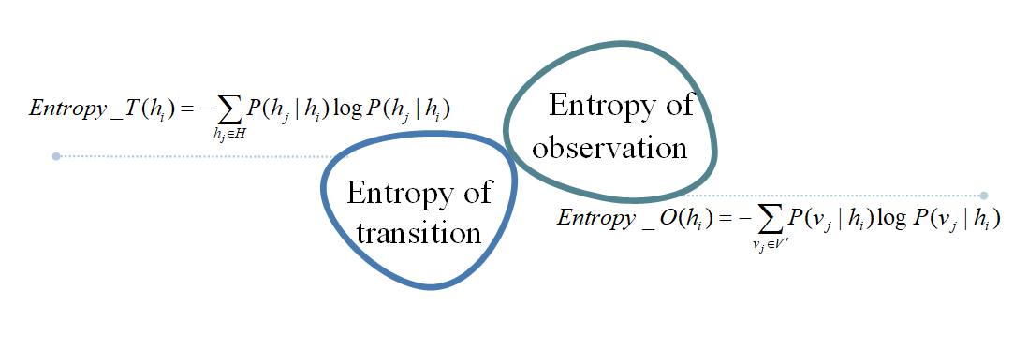
Solution
2.3
Relevance Features
Based on Markov Modeling

Slide 11
Solution
3.1
Poor Performance Discovery
Single-task approaches for performance discovery
Predicting performance on all courses as a whole
Training model for each course independently

Slide 12
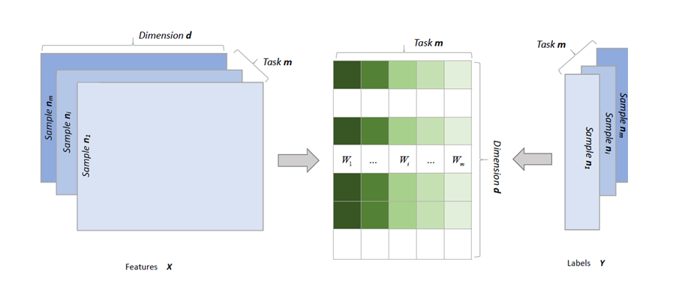
Solution
3.2
Poor Performance Discovery
Regularized Multi-task Modeling

Slide 13
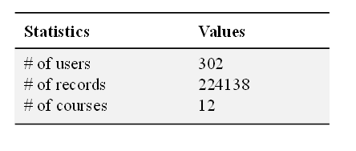
Experiments
Experiments data set
Imbalanced data preprocessing
SMOTE

Slide 14
Experiments
Selecting parameters
Five-flod cross validation based on grid search
Imbalanced data preprocessing
Accuracy
Precision
Recall
F1 Score
ROC&&AUC

Slide 15
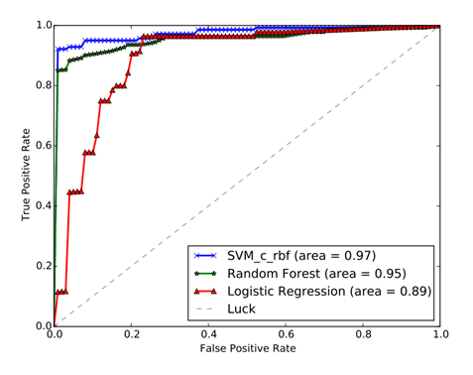
Experiments
Different single-task model
Logistic Regression
SVM with RBF kernel
Random Forests
Comparison result
Coarse-grained single-task models achieve a good outcome
Behavior features are effective to poor performance discovery

Slide 16
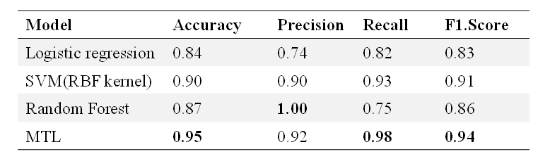
Experiments
Comparison between single task and multi-task models
Multi-task model shows good results, especially high recall

Slide 17
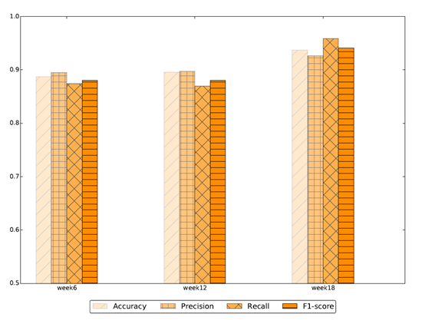
Experiments
Early warning
The metrics are high in the early stage of the semester

Slide 18
Conclusion
B
Smart Card Reconds
Behavior Sequences
Hidden Markow Model
Performance
Behavior Pattern Building
Statistic Features
Relevant Features
Multitask Model
Behavior Feature Extration
0
0
...
1
1
0
...
0
0
1
...
0
A General Framework to Discover Poor Performance

Slide 19
Conclusion
Build behavior pattern and extract features
Statistics features
Relevance features
Use a regularized multi-task model

Slide 20
Conclusion
Early Warning

Slide 21
Future Work
The correlation between behavior and scholarship

